Slide 1


OBJECT ORIENTED PROGRAMMING
MINI PROJECT
CALCULATOR

Slide 2


Slide 3


Slide 4
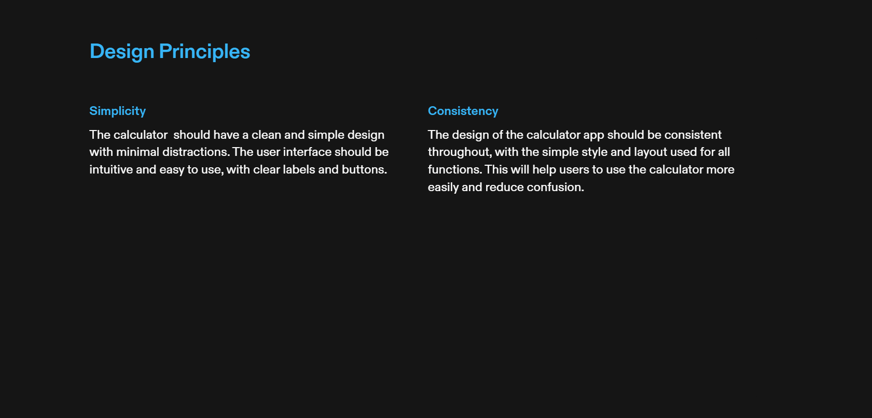

Slide 5
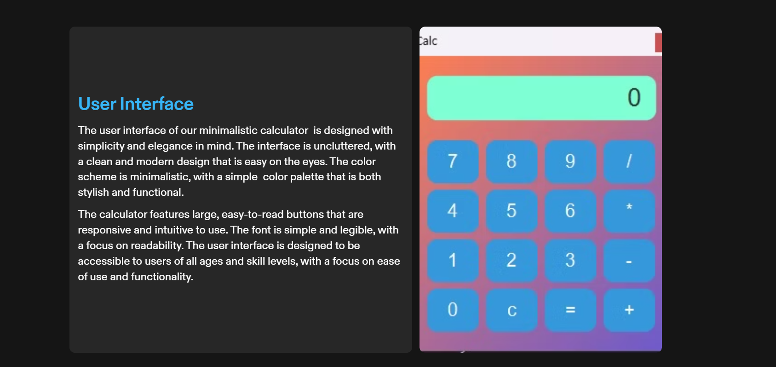

Slide 6
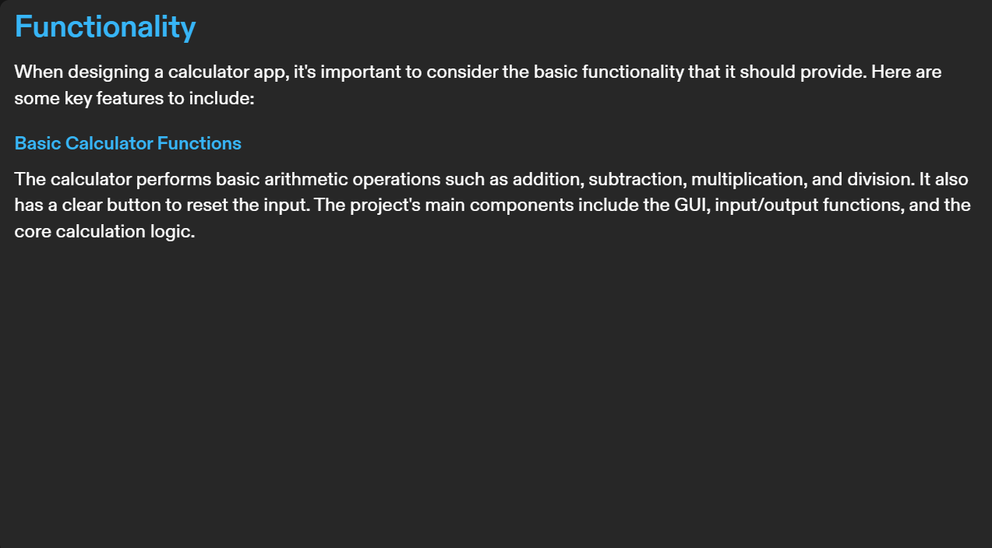



Slide 7
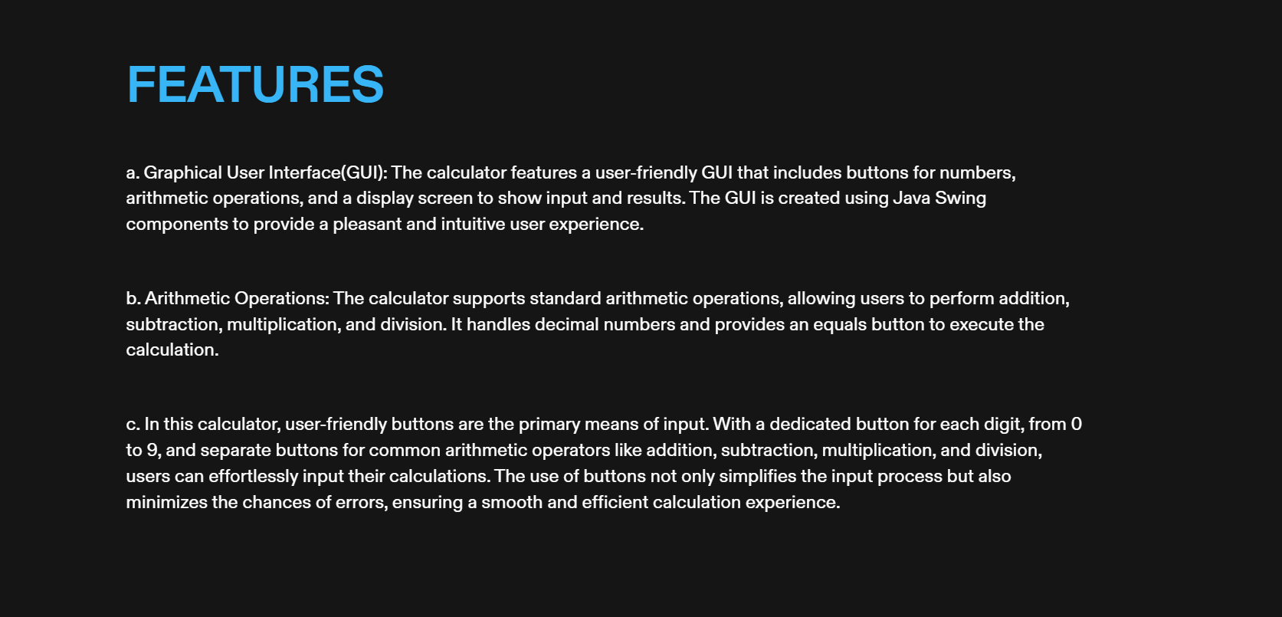

Slide 8
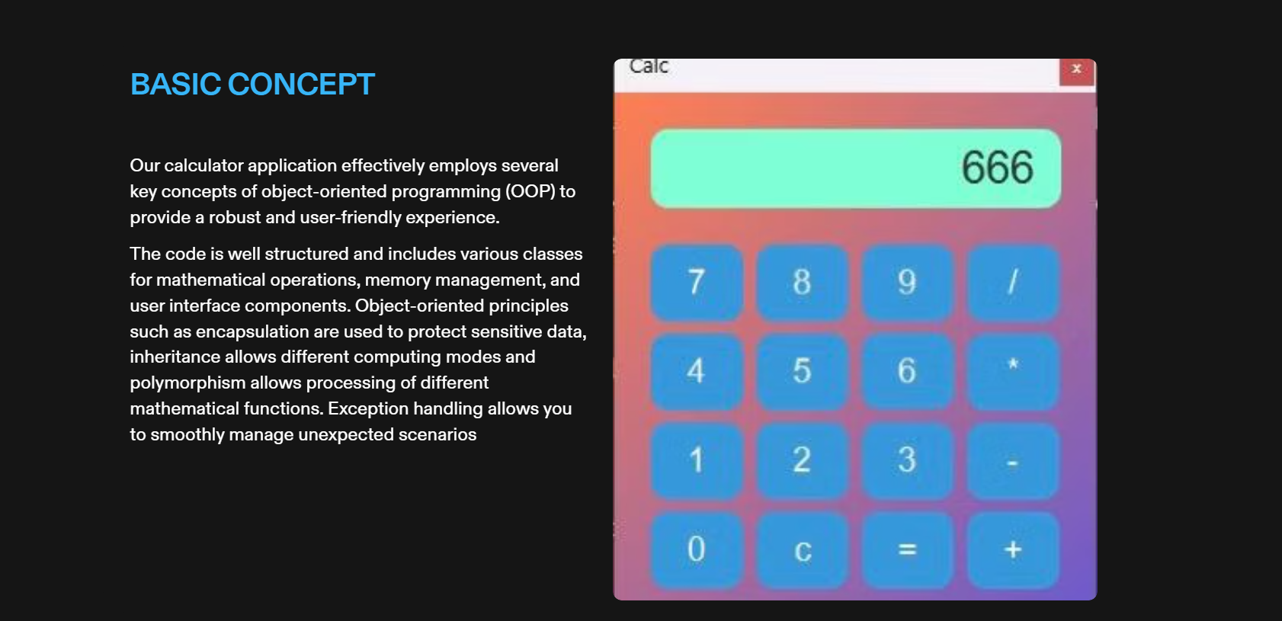

Slide 9
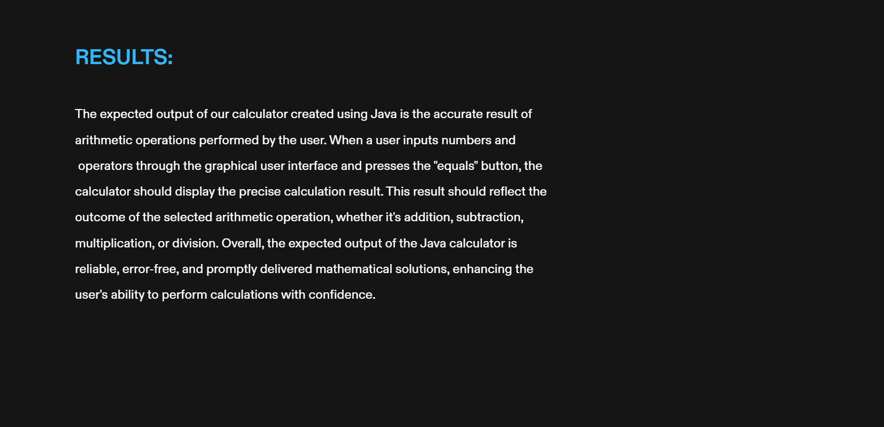


Slide 10



Slide 11

THANK YOU!!!
GROUP MEMBERS:
SAIVA
SINGH
RIPUDAMAN
PANWAR
SAIVA
SINGH
PRATHIT
KAPIL
RISHIT
MaNDAL
ROLL NO : 43
ROLL NO : 44
ROLL NO : 45
ROLL NO : 46
Reg no: 220905350
Reg no: 220905370
Reg no: 220905378
Reg no: 220905390

